Slide 1
FATIMA Daily Weather Briefing
July 17
WRF forecast
Zheqi Chen

Slide 2
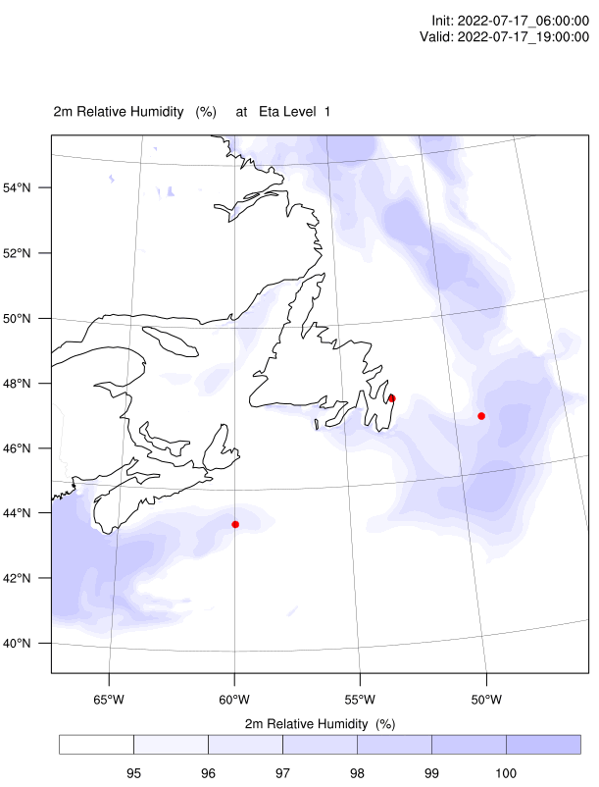
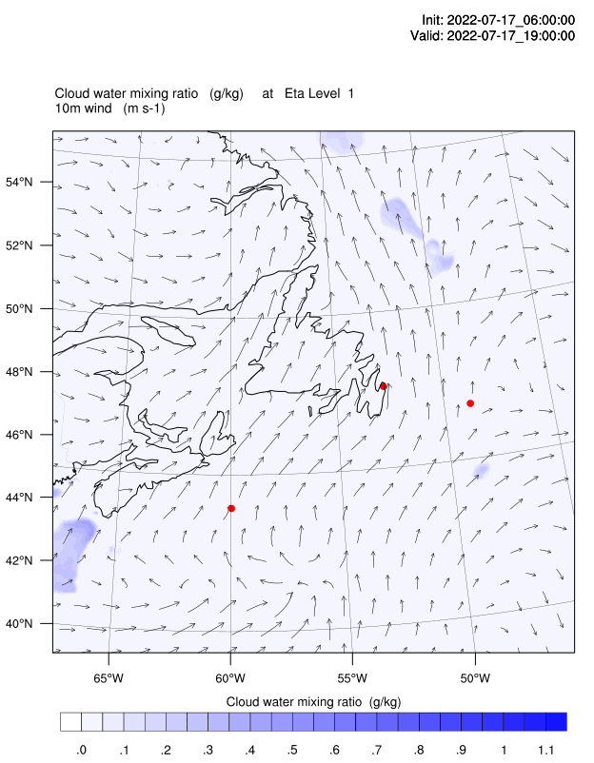
4m cloud water & 10m wind
Droplet number = 10^8/m^3 over water

Slide 3
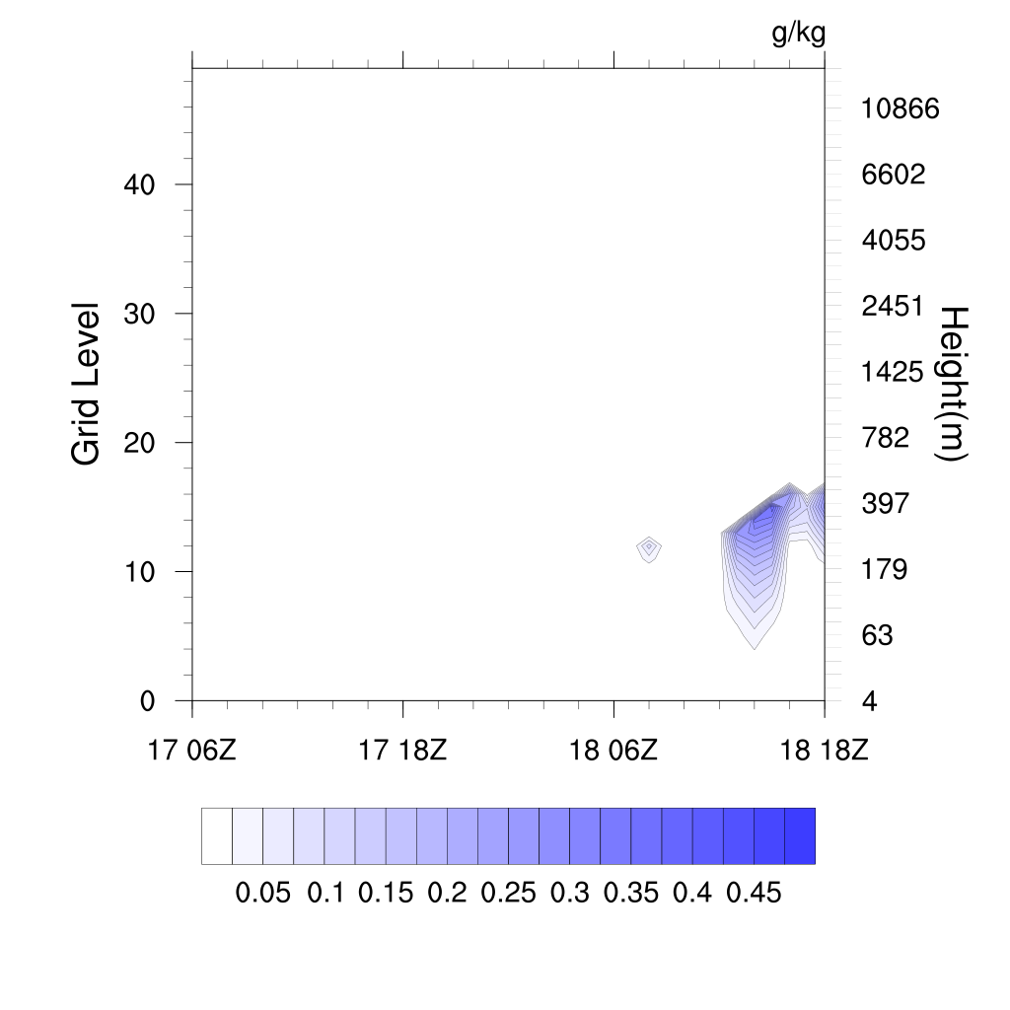
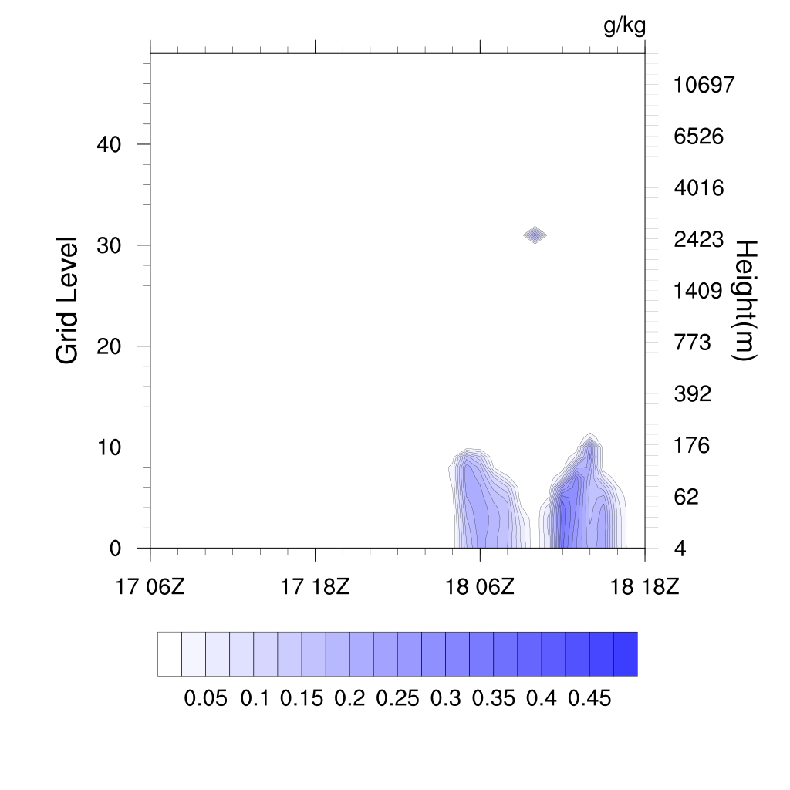
First 12 hours of the plot is spin up time
Sable Island
Hibernia oil platform

Slide 4
 | SI today | SI tomorrow | Condor today | Condor tomorrow | Hibernia today | Hibernia tomorrow
10m Wind speed (m/s) | 5-6 | 7-8 |  |  | 5-7 | 6-8
Wind direction | S | SW |  |  | S | SSW
Fog chance | 40% | 50% |  |  | 50% | 70%
Tomorrow is until 18Z

